Slide 1
Getting Started with PSU’s ICS-ACI Network and Using OpenFOAM

Slide 2
Presentation Overview
Accessing the ACI Network
Using the ACI Network
Accessing OpenFOAM on ACI

Slide 3
Accessing the ACI Network → Exceed OnDemand
Exceed OnDemand is the software recommended by Penn State for remotely connecting to the ACI network.
Click HERE to navigate to Penn State’s ICS page to download Exceed OnDemand.
After successfully downloading Exceed OnDemand you will be prompted to login, do so using your PSU credentials and the host name: aci-i.aci.ics.psu.edu.
Note that two-factor authentication is automatically enabled for Exceed OnDemand login.

Slide 4
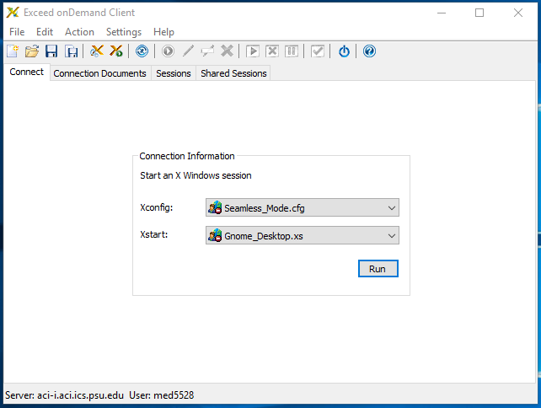
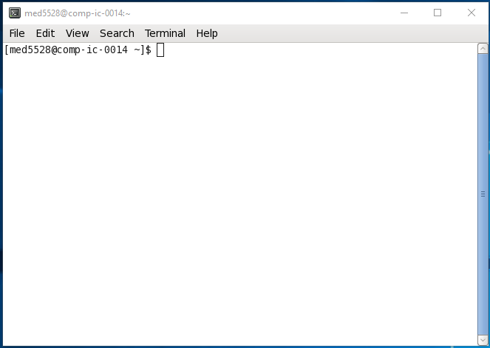
Accessing the ACI Network → Exceed OnDemand
After you successfully login to Exceed OnDemand you will be prompted to select how you want to interface with ACI. I have found the interface configuration shown in Figure A to work best. After configuring your ACI interface you are now connected to ACI. The command window can be accessed using Applications → System Tools → Terminal and will open a window like the one shown in Figure B.
A
B

Slide 5
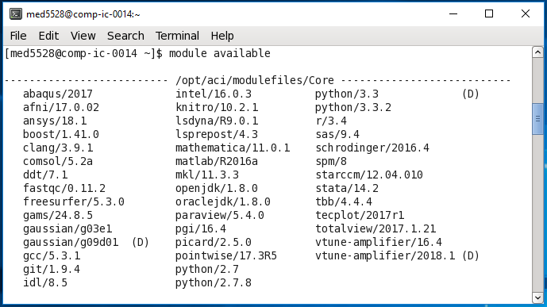
Using the ACI Network → Basic Navigation
After gaining access to the ACI network you must select and load whichever software you want to use. A pre-loaded software on ACI is called a module. All pre-loaded modules available for execution on ACI can be viewed using the following command: module available. An example of the executed command is shown below.

Slide 6
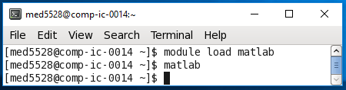
Using the ACI Network → Basic Navigation
If the software you want to use is displayed in the returned list of available modules you can open the software using two window commands. For simplicity, we will use the software MATLAB as an example.
Window Command #1: module load matlab
Window Command #2: matlab
An example of the executed commands is shown below.

Slide 7
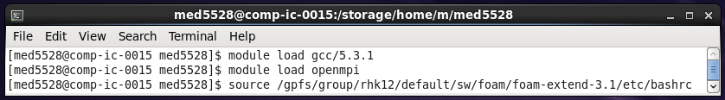
Accessing OpenFOAM on ACI → Loading from Directory
If the software you want to use is NOT displayed in the returned list of available modules (such as OpenFOAM) you must manually load the software. OpenFOAM will be loaded from the CompBio directory. Three commands, executed consecutively, are needed to load OpenFOAM from the group directory.
Window Command #1:
module load gcc/5.3.1
Window Command #2:
module load openmpi
Window Command #3:
source /gpfs/group/rhk12/default/sw/foam/foam-extend-3.1/etc/bashrc

Slide 8
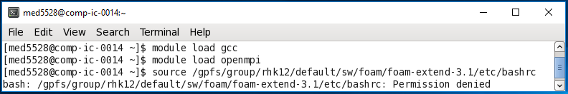
Accessing OpenFOAM on ACI → Loading from Directory
If after entering the 3rd command prompt mentioned on the previous slide you are presented with a permission denied message similar to the one shown in the command window below you do not have permission* to access the group directory.
*Email Dr. Kraft if you are presented with this message and he will contact PSU ICS to update your account permissions.

Slide 9
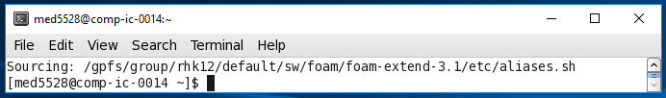
Accessing OpenFOAM on ACI → Loading from the Directory
OpenFOAM loaded successfully if you are presented with a command window similar to the one shown below. Every time OpenFOAM is to be used on the ACI network it must be loaded from the CompBio directory.

Slide 10
Using OpenFOAM→ Useful Resources
OpenFOAM does not have a user-interface. All interfacing with the software must be done using the command window. An extremely useful website for OpenFOAM instruction and guidance can be found HERE.
An extremely useful website for Linux syntax can be found HERE.

